Slide 1
Be CLOSE to RISKS
ENTERPRISE RISK MANAGEMENT
Tashkent, April 2011

Slide 2
BUSINESS WORLD OF (RE) SURPRISES
WE ARE ON THE SAME BOAT – KNOWN AND UNKNOWN RISKS!

Slide 3
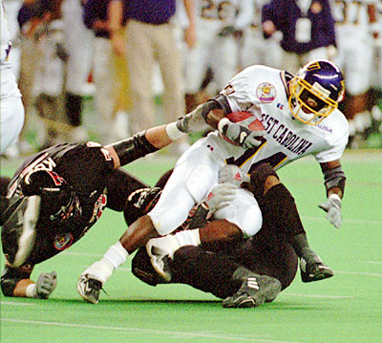
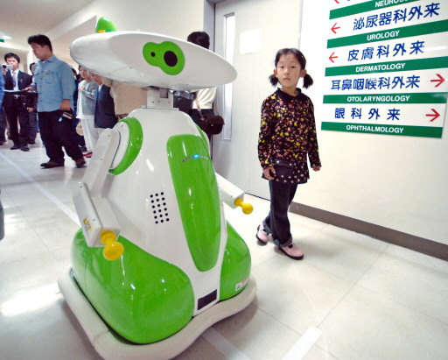
RISKS ARE FROM FAR AND NEAR
SPEED
INTERNET
NATURE
INNOVATION
Notes:
3
Recreational System

Slide 4
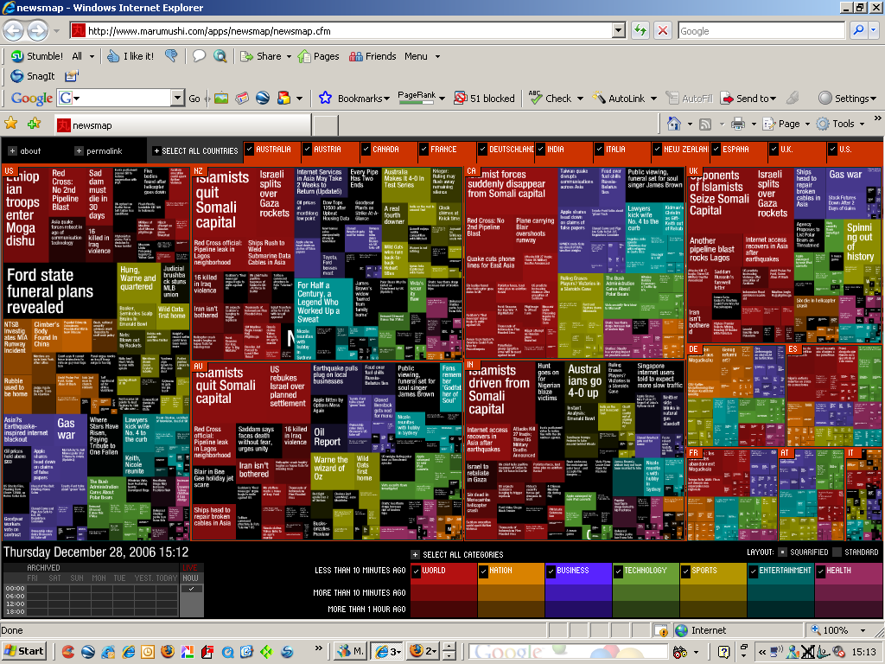
COMLEXITY OF RISKS IS INCREASING

Slide 5
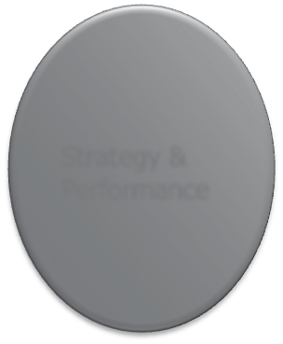
CHANGES + QUESTIONS = CONSTANT
TACTICS
REGULATION
RISK
BUSINESS PROCESS AND MODELS
STRATEGY
Notes:
5

Slide 6
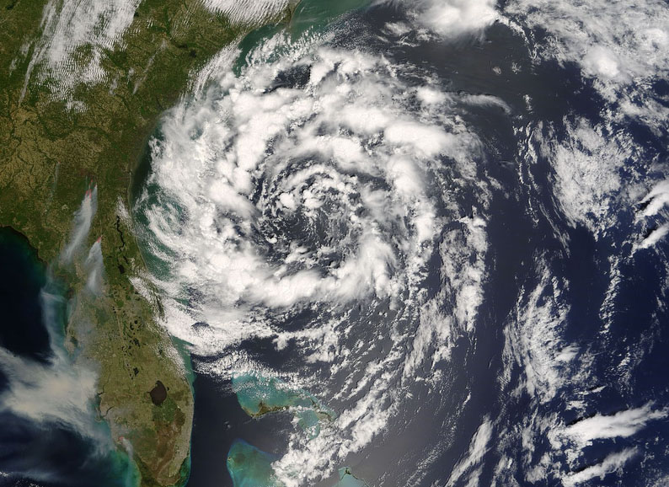
CHALLENGES FOR (RE)INSURANCE
DEMOGRAPHY CHANGES
REGULATONS
NEW RISKS
SUPERVISIONS
NEW CRISIS
NAT CATASTROPHES

Slide 7
ENTERPRISE RISK MANAGEMENT = E.R.M.
COSO Definition of E.R.M.
A comprehensive, systematic approach for helping all organizations, regardless of size or mission to:
IDENTIFY
MEASURE
PRIORITIZE
RESPOND
TO THE RISKS
WHAT LEVEL OF RISK it can, or wants to accept in its endeavours to build SHAREHOLDER VALUE

Slide 8
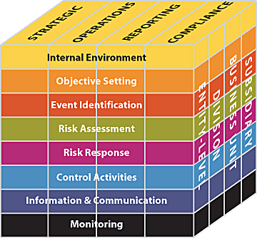
E.R.M. FRAME
GOALS
STRATEGIC
OPERATION
REPORTING
COMPLIANCE
ORGANIZATION
Source: COSO Enterprise Risk Management – Integrated Framework. 2004. COSO.

Slide 9
E.R.M. – BASIC DEFINITIONS
EXECUTIVE SPONSOR
A Key Senior Manager, respected by both the CEO and Chairman, with clear authority able to influence key business managers to get their staff involved and committed.
RISK CHAMPION
The Risk Champion acts as a change agent in the E.R.M. process, i.e. Key Business Area Managers.
RISK
The threat or probability that an action or event will adversely or beneficially affect an organization’s ability to achieve its objectives
RISK APPETITE
The amount of risk exposure, or potential adverse impact from an event, that the organization is willing to accept/retain.

Slide 10
E.R.M. – BASIC DEFINITIONS
RISK REGISTER
Describes the nature and provides the assessment of the likelihood and potential impact of a range of different risks that may directly affect the organization.
RISK CONTROL
The corporate response to treating identified risks.
SILO RISK MANAGEMENT
The management of a specific risk by a specific function using its own tools and applications without regard to or communication with other business lines.

Slide 11
PARTICIPANS IN AN E.R.M. PROGRAM
STRATEGIC PLANNIG
Identify any external threats and competitive opportunities.
Identify the strategic objectives of the organization that will serve
to define the risk appetite of the organization.
ACCOUNTING / FINANCIAL CONTROL
Identify financial reporting risks and asset valuation risks
LEGAL DEPARTMENT
Litigation management and analysis of emerging legal trends that
may affect the Company
OPERATION
Ensuring the day – to – day running of the Company

Slide 12
PARTICIPANS IN AN E.R.M. PROGRAM
IT DEPARTMENT
Identify potential hazards, backup problems, data security leaks, etc
CUSTOMER SERVICE
Ensuring prompt and proper customer complaint handling and timely reporting of complaint causes to operations and other departments for resolution
ACTUARIAL
Reserving, Pricing, Capital Modeling, Dynamic Financial Analysis, Retention Analysis, Stress Testing, etc
INTERNAL AUDIT
Audit the risk management process

Slide 13
WHY THE NEED FOR E.R.M.?
Helps organizations identify, analyze, manage and monitor risks comprehensively
Focus on the strategic analysis of risk throughout an organization
Helps align the organization’s RISK APPETITE with its overall business strategy, deciding how much UNCERTAINTY is acceptable and how much could actually add value

Slide 14
WHAT IS THE GOAL OF E.R.M.?
To help preserve and enhance / create value
accomplished by
providing the organization with better RISK information
that can lead to improved DECISION making

Slide 15
E.R.M. CHALLENGES
Embedding the risk management culture
Obtaining buy-in from the board, senior management,
business unit management, and staff
Ensuring widespread understanding and the involvement of all
business units
Ensuring consistent risk profiling and risk management reporting
Adhering to continuously changing regulatory environments
Acknowledging that we are managing risks in a Dynamic and
Uncertain World

Slide 16
WHAT MUST BE DONE?
Define the risk universe - our set of risks
Agree on a common risk language
Embark on a risk education process
Assess the current state of risk awareness
Define risk appetite and set levels of risk tolerance
Assess risks
Identify and evaluate any existing controls
Decide appropriate risk responses (accept, avoid, share, mitigate) to
each of the risks in our risk portfolio
Integrate controls with responses

Slide 17
INSTEAD OF CONCLUSION
AT THE BEGINING
PEOPLE
KNOW HOW + EXPERIENCE + MOTIVATION + COMMUNICATION + DECISION
E.R.M.
GOOD WILL + TRUST
CAPITAL + I.T.
Notes:
17

Slide 18
TRUST RE UWR SUMMARY y 2011
TREATY CAPACITIES
Non-Marine: US$7,500,000
Marine: US$3,750,000
FACULTATIVE CAPACITIES
Energy Onshore: US$40 mio on PML
Energy Offshore: US$40 mio on PML
Property: US$30 mio on PML
Engineering: US$21 mio on PML
Liability: US$5 mio per occurrence
Marine Hull: US$8,750,000
Marine Cargo: US$8,750,000
Notes:
18

Slide 19
TRUST RE CONTACTS
TRUST RE, CYPRUS
Sinisa Lovrincevic
Head of Business Development
Ariadne House, 4th Floor, 333
28th October Street
P.O. Box 58024, CY 3730
Limassol, Cyprus
T+: (+357) 25 582 329
F+: (+357) 25 591 074
M+: (+357) 99 722 665
sinisal@trustrecyprus.com
TRUST RE, BAHRAIN
Jalal Tabaja
Regional Manager
Underwriter - Marine & Energy
Trust Tower, Building 125
Road 1702, Diplomatic Area 317
P.O. Box 10002
Manama, Kingdom of Bahrain
T+: (+973) 17 517 192
F+: (+973) 17 531 586
M+: (+973) 36 899 855
jtabaja@trustgroup.net.bh
TRUST RE, BAHRAIN
Emir Erguner
Deputy Regional Manager
Deputy Underwriter - Treaty
Trust Tower, Building 125
Road 1702, Diplomatic Area 317
P.O. Box 10002
Manama, Kingdom of Bahrain
T+: (+973) 17 517 171, Ext. 1212
F+: (+973) 17 531 586
M+: (+973) 36 899 897
eerguner@trustgroup.net.bh
Notes:
19

Slide 20
Thank You for Attention!
TRUST RE RATING
A- (Excellent) by A.M. Best
BBB+ / Stable / by S&P
www.trustgroup.net

